Slide 1

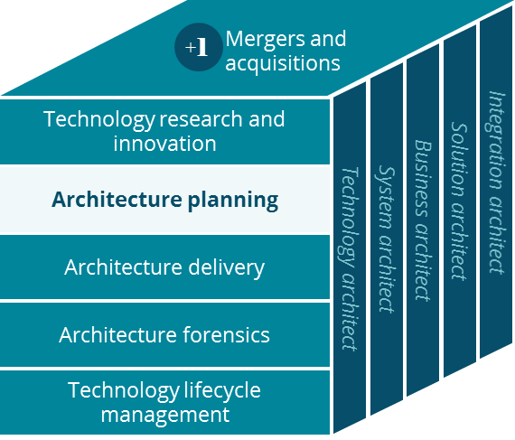
Health Fund Administration Business Canvas
Systems Planning
April 2019

Slide 2
Health Fund Administration Business Canvas
Holistic view of the current Health Fund Administration business model
Key Partnerships
Key Activities
Value Proposition
Customer Relationships
Customer Segment
Financial Account Management
Tax savings options for Health, Adoption, Commuter, and Tuition expenses
Employees
Dependents
Employers
Employers
Financial Services Company
Debit Card Processing
Member Management
Monitor and report on tax compliance
State/Federal Tax Agencies
Regulatory Compliance
Simplified Tax Savings Account Self-Service
Tax-Advantage Education & Guidance
Flexible Contribution Methods
Channels
Key Resources
Facilitate Health Fund Payments
Systems of Engagement (Web/Mobile)
Debit Card
Customer Care
Tax Free Interest
Fax
Social Media
IT Platforms
Digital Platforms
Tax Free Payments
Data & Insights
Direct Billing
Mail
Phone
Cost Structure
Revenue Streams
Financial Accounts Administration
Customer Education
Fund Administration Fees PM/PM
IT Systems
Sales & Marketing
Long-term Investments
Notes:
Future state diagram (yale) => http://aetnet.aetna.com/technet/near/pages/821d83f94921012f.htm

Slide 3
Health Fund Administration Products
Flexible Spending Accounts (FSAs)
Health Savings Accounts (HSAs)
Health Reimbursement Arrangements (HRAs)
Adoption Assistance
COBRA
Commuter Benefits
Tuition Assistance

